Slide 1
In General (binary)
No. of bits | Binary
 | Min | Max
n | 0 | 2^{n} - 1
Remember !!

Slide 2
Signed Integers
Previous examples were for “unsigned integers” only!
Must also have a mechanism to represent “signed integers” (positive and negative values!)
E.g., -5₁₀ = ?₂
Two common schemes: 1) sign-magnitude 2) two’s complement

Slide 3
Sign-Magnitude
Extra bit on left to represent sign
  0 = positive value
  1 = negative value
E.g., 6-bit sign-magnitude representation of +5 and –5:
+5: 0 0 0 1 0 1
-5: 1 0 0 1 0 1
+ve
5
-ve
5

Slide 4
Ranges (revisited)
No. of bits | Binary
 | Unsigned |  | Sign-magnitude
 | Min | Max | Min | Max
1 | 0 | 1
2 | 0 | 3 | -1 | 1
3 | 0 | 7 | -3 | 3
4 | 0 | 15 | -7 | 7
5 | 0 | 31 | -15 | 15
6 | 0 | 63 | -31 | 31
Etc.

Slide 5
In General (revisited)
No. of bits | Binary
 | Unsigned |  | Sign-magnitude
 | Min | Max | Min | Max
n | 0 | 2^{n} - 1 | -(2^{n-1} - 1) | 2^{n-1} - 1

Slide 6
Difficulties with Sign-Magnitude
Two representations of zero
  Using 6-bit sign-magnitude…
    0: 000000
    0: 100000
Arithmetic is awkward!

Slide 7
Complementary Representations
1’s complement
2’s complement

Slide 8
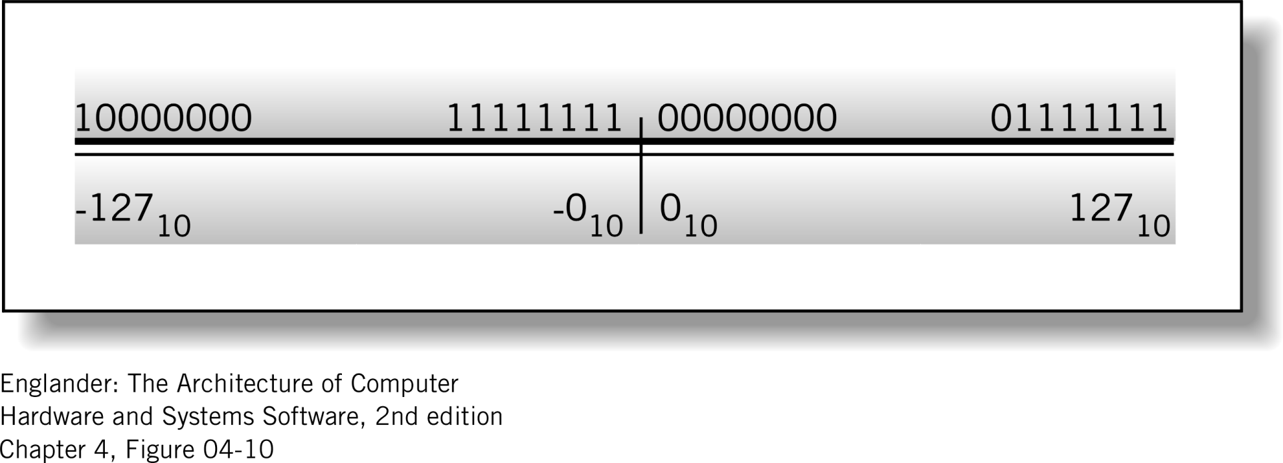
One’s complement representation
-
+
Figure 4.10 One’s complement representation

Slide 9
Finding one’s complement for a negative Number
Invert the bits !
For example one’s complement of -58 using 8 bits
0011 1010 = 58
1100 0101 = -58

Slide 10
Addition
Add 2 positive 8-bit numbers
Add 2 8-bit numbers with different signs
  Take the 1’s complement of 58 (i.e., invert)
  0011 1010
  1100 0101
0010 1101 | = | 45
0011 1010 | = | 58
0110 0111 | = | 103
0010 1101 | = | 45
1100 0101 | = | –58
1111 0010 | = | –13
0000 1101
8 + 4 + 1 | = | 13
Invert to get magnitude

Slide 11
Addition with Carry
8-bit number
  0000 0010 (2₁₀)
  1111 1101
  Add
  9 bits
  End-around carry
0110 1010 | = | 106
1111 1101 | = | –2
10110 0111
+1
0110 1000 | = | 104

Slide 12
Subtraction
8-bit number
  Invert
  0101 1010 (90₁₀)
  1010 0101
  Add
  9 bits
  End-around carry
0110 1010 | = | 106
-0101 1010 | = | 90
0110 1010 | = | 106
–1010 0101 | = | 90
10000 1111
+1
0001 0000 | = | 16

Slide 13
Overflow
8-bit number
  256 different numbers
  Positive numbers:
  0 to 127
Add
  Test for overflow
  2 positive inputs
  produced negative
  result overflow!
  Wrong answer!
0100 0000 | = | 64
0100 0001 | = | 65
1000 0001 |  | -126
0111 1110
126₁₀
Invert to get magnitude

Slide 14
Two’s Complement
Most common scheme of representing negative numbers in computers
Affords natural arithmetic (no special rules!)
To represent a negative number in 2’s complement notation…
    Decide upon the number of bits (n)
    Find the binary representation of the positive value in n-bits
    Flip all the bits (change 1’s to 0’s and vice versa)
    Add 1
Learn!

Slide 15

Two’s complement representation
Figure 4.12 Two’s complement representation

Slide 16
Two’s Complement Example
Represent –5 in binary using 2’s complement notation
    Decide on the number of bits
    Find the binary representation of the +ve value in 6 bits
    Flip all the bits
    Add 1
6 (for example)
000101
+5
111010
111010
+ 1
111011
-5

Slide 17
Sign Bit
In 2’s complement notation, the MSB is the sign bit (as with sign-magnitude notation)
  0 = positive value
  1 = negative value
+5: 0 0 0 1 0 1
-5: 1 1 1 0 1 1
+ve
5
-ve
? (previous slide)

Slide 18
“Complementary” Notation
Conversions between positive and negative numbers are easy
For binary (base 2)…
2’s C
+ve
-ve
2’s C

Slide 19
Example
+5
0 0 0 1 0 1
2’s C
1 1 1 0 1 0
+ 1
-5
1 1 1 0 1 1
2’s C
0 0 0 1 0 0
+ 1
+5
0 0 0 1 0 1

Slide 20
Exercise – 2’s C conversions
What is -20 expressed as an 8-bit binary number in 2’s complement notation?
  Answer:
1100011 is a 7-bit binary number in 2’s complement notation. What is the decimal value?
  Answer:

Slide 21
Exercise – 2’s C conversions
Answer
What is -20 expressed as an 8-bit binary number in 2’s complement notation?
  Answer: 11101100
1100011 is a 7-bit binary number in 2’s complement notation. What is the decimal value?
  Answer: -29

Slide 22
Detail for -20 -> 11101100
-20₁₀: Positive Value = 00010100
“Flip”: 11101011
Add 1: + 1
11101100
(One’s complement)
kc

Slide 23
Detail for 1100011 -> - 29
2’s Complement: 1100011
“Flip”: 0011100
Add One: + 1
0011101
Converts to: = - 29
(One’s complement)
kc

Slide 24
Range for 2’s Complement
For example, 6-bit 2’s complement notation
100000
100001
111111
000000
000001
011111
-32 -31 ... -1 0 1 ... 31
Negative, sign bit = 1
Zero or positive, sign bit = 0

Slide 25
Ranges (revisited)
No. of bits | Binary
 | Unsigned |  | Sign-magnitude |  | 2’s complement
 | Min | Max | Min | Max | Min | Max
1 | 0 | 1
2 | 0 | 3 | -1 | 1 | -2 | 1
3 | 0 | 7 | -3 | 3 | -4 | 3
4 | 0 | 15 | -7 | 7 | -8 | 7
5 | 0 | 31 | -15 | 15 | -16 | 15
6 | 0 | 63 | -31 | 31 | -32 | 31
Etc.

Slide 26
In General (revisited)
No. of bits | Binary
 | Unsigned |  | Sign-magnitude |  | 2’s complement
 | Min | Max | Min | Max | Min | Max
n | 0 | 2^{n} - 1 | -(2^{n-1} - 1) | 2^{n-1}-1 | -2^{n-1} | 2^{n-1} - 1
Hint! Learn this table!

Slide 27
2’s Complement Addition
Easy
No special rules
Just add

Slide 28
What is -5 plus +5?
Zero, of course, but let’s see
Sign-magnitude
Two’s-complement
-5: 10000101
+5: +00000101
10001010
1
1
1
1
1
1
1
1
-5: 11111011
+5: +00000101
00000000

Slide 29
2’s Complement Subtraction
Easy
No special rules
Just subtract, well … actually … just add!
A – B = A + (-B)
add
2’s complement of B

Slide 30
What is 10 subtract 3?
7, of course, but…
Let’s do it (we’ll use 6-bit values)
10 – 3 = 10 + (-3) = 7
+3: 000011
1s C: 111100
+1: 1
-3: 111101
001010
+111101
000111

Slide 31
What is 10 subtract -3?
(-(-3)) = 3
13, of course, but…
Let’s do it (we’ll use 6-bit values)
10 – (-3) = 10 + (-(-3)) = 13
-3: 111101
1s C: 000010
+1: 1
+3: 000011
001010
+000011
001101

Slide 32
Overflow
The result of the calculation does not fit the available number of bits for the result
Ex: 1 sign bit, 2 bits for the number
010 +
010
----------------
100
Detection: sign of the result is different then the signs of the operands

Slide 33
Overflow
8-bit number
  256 different numbers
  Positive numbers:
  0 to 127
Add
  Test for overflow
  2 positive inputs
  produced negative
  result overflow!
  Wrong answer!
0100 0000 | = | 64
0100 0001 | = | 65
1000 0001 |  | -127
0111 1111
127₁₀
Take 2’s complement to get magnitude

Slide 34
Carry
The result of an addition (or subtraction) exceeds the allocated bits, independently of the sign
Ex: 1 sign bit, 2 bits for the number (carry, not overflow)
010 +
110
-----------
1000

